Slide 1
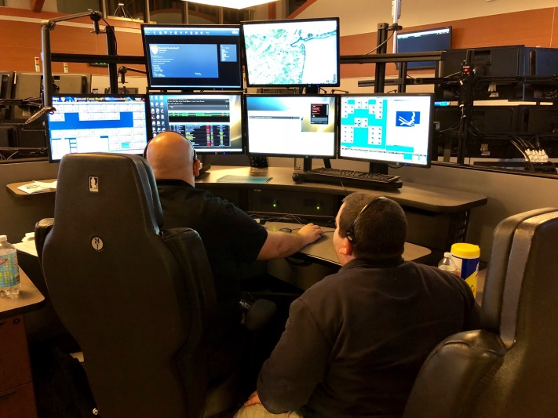

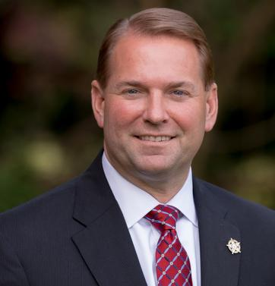
MONMOUTH COUNTY
SHERIFF'S OFFICE
Communications Division Orientation
“Alone we can do so little, together we can do so much.”
-Helen Keller
Professional Standards • 9-1-1 Operations • Training • Hiring Process
www.monmouthsheriff.org
Sheriff Shaun Golden
Notes:
[Sources]
- User-provided source deck: "2024 Monmouth County Sheriffs Office Orientation 1-22-2026 rev.pptx" (content adapted and redesigned)

Slide 2
MONMOUTH COUNTY
SHERIFF’S OFFICE
Sheriff Shaun Golden
www.monmouthsheriff.org

Slide 3
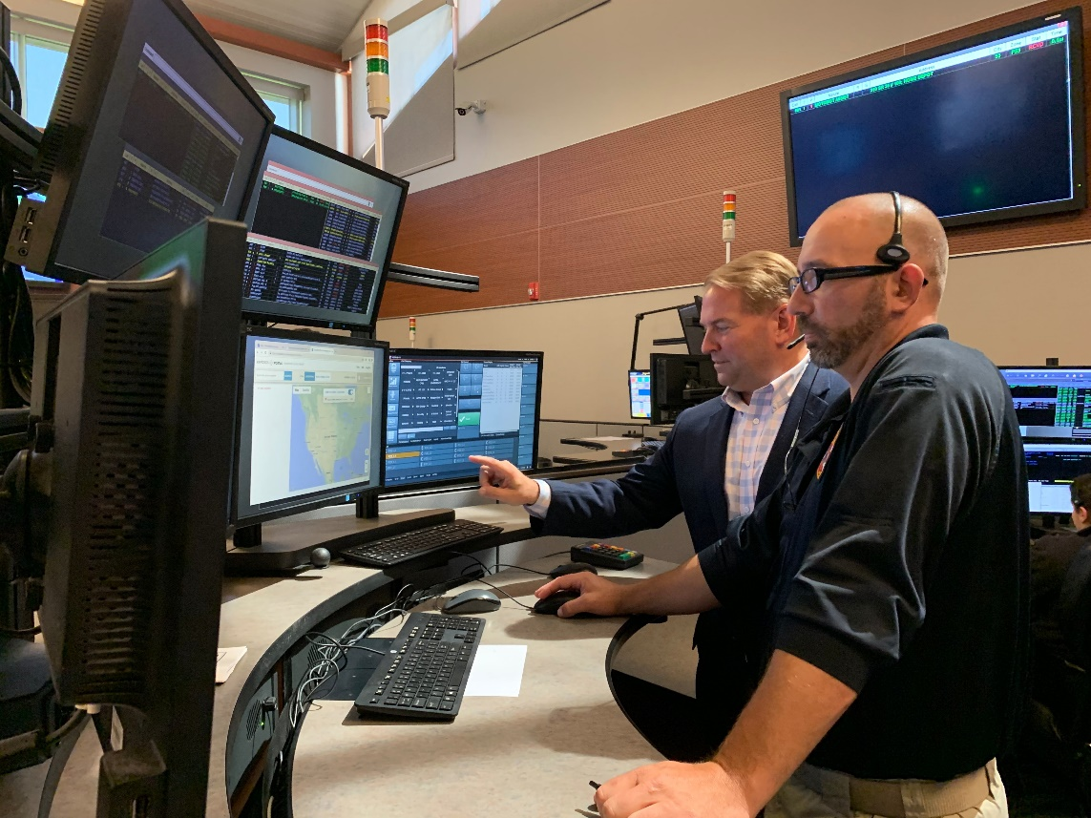
Leadership and Orientation Contacts
The people most closely connected to communications operations, training, and recruitment.
Primary contacts
Phil Meehan
Undersheriff, Communications
Dawn Sommeling
9-1-1 Coordinator
Elliot Belote
Supervisor / New Operator Training
Communications is a 24/7 operation. Orientation, training, scheduling, and candidate communications are coordinated around operational need.
Stephanie Itri
Recruitment Liaison • sitri@mcsonj.org
For documents and certifications, send materials directly to the recruitment contact listed above.
Notes:
[Sources]
- User-provided source deck: "2024 Monmouth County Sheriffs Office Orientation 1-22-2026 rev.pptx" (content adapted and redesigned)

Slide 4

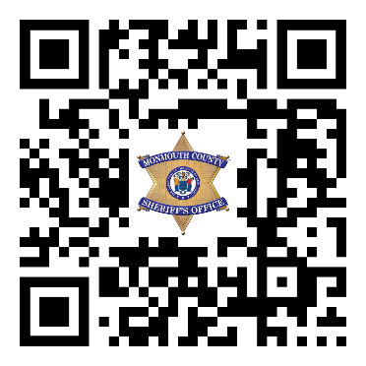




SCAN ME
#MCSONJ
Follow, Like, & Tag Us!

Slide 5
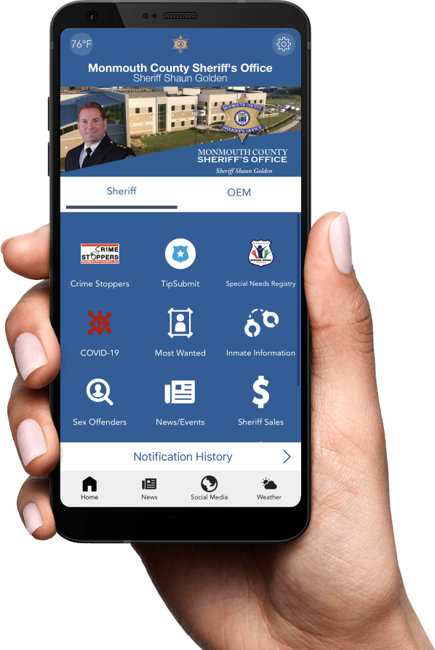

Download Our App

Slide 6


Slide 7


Slide 8

What the Communications Division Does
Countywide 9-1-1 intake and dispatch support for police, fire, EMS, and partner agencies.
Core mission
Receive and disseminate emergency and non-emergency calls for assistance.
Serve as the Monmouth County Public Safety Answering Point (PSAP) for 9-1-1.
Dispatch emergency resources and support contracted or requested (50) agencies across the county.
Operate 24 hours a day, 7 days a week, 52 weeks a year.
734,458
2,012
84 / hr
calls processed in 2024
per day
about 1.5 per minute
Notes:
[Sources]
- User-provided source deck: "2024 Monmouth County Sheriffs Office Orientation 1-22-2026 rev.pptx" (content adapted and redesigned)

Slide 9



Accreditation and Professional Standards
The division operates inside a highly structured, standards-driven law enforcement environment.
CALEA highlights
One of only four accredited agencies in the State of New Jersey.
Initial accreditation achieved in 2001.
Latest review completed in March 2024.
CALEA standards span organization, supervision, human resources, recruitment, training, operations, and critical incidents.
FIVE STAR
★★★★★
ACCREDITED AGENCY
Monmouth County Sheriff's Office is recognized as a CALEA Tri-Arc agency.
Notes:
[Sources]
- User-provided source deck: "2024 Monmouth County Sheriffs Office Orientation 1-22-2026 rev.pptx" (content adapted and redesigned)

Slide 10
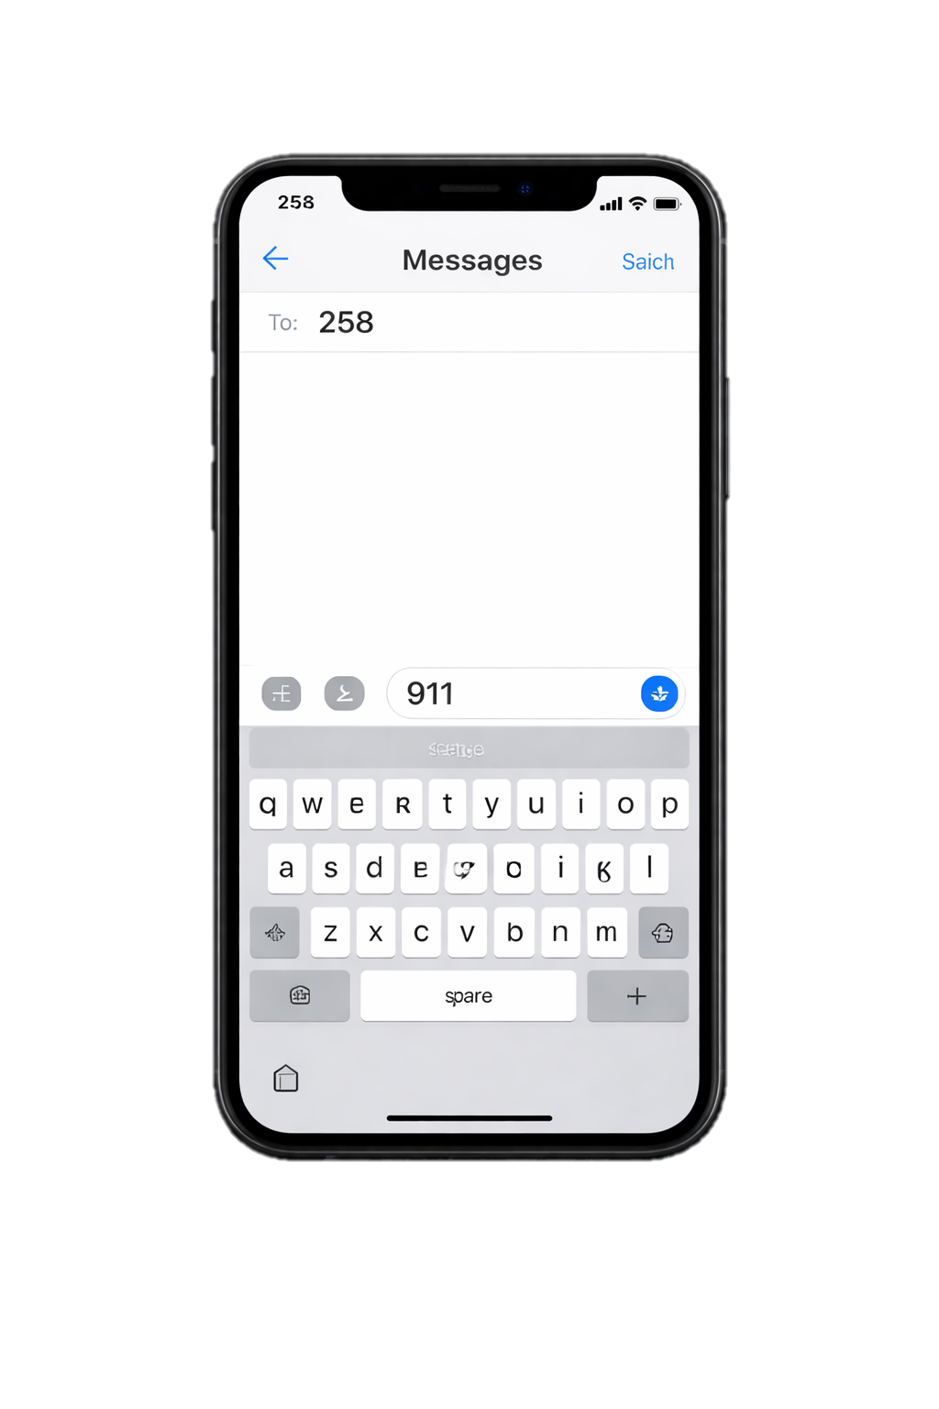


Operational Footprint
Scope of service across call taking, dispatch, notifications, and supporting systems.
Dispatch coverage
50 agencies supported by the county PSAP
31
Police agencies dispatched
Additional activity metrics
106
Fire agencies dispatched
258
Text to 9-1-1
55
EMS agencies dispatched
NYC 911 / 311
23,244
911H activity
5,236
after-hours county agency notifications in 2023
19,349
911O activity
3,600/hr
ALPR volume (about 1 per second)
Notes:
[Sources]
- User-provided source deck: "2024 Monmouth County Sheriffs Office Orientation 1-22-2026 rev.pptx" (content adapted and redesigned)

Slide 11





Public Safety Dispatch Point
31
POLICE AGENCIES
106
FIRE AGENCIES
55
EMS AGENCIES
5,236 notifications to county agencies in 2023
Notes:
[Sources]
- User-provided source deck: "2024 Monmouth County Sheriffs Office Orientation 1-22-2026 rev.pptx" (content adapted and redesigned)

Slide 12
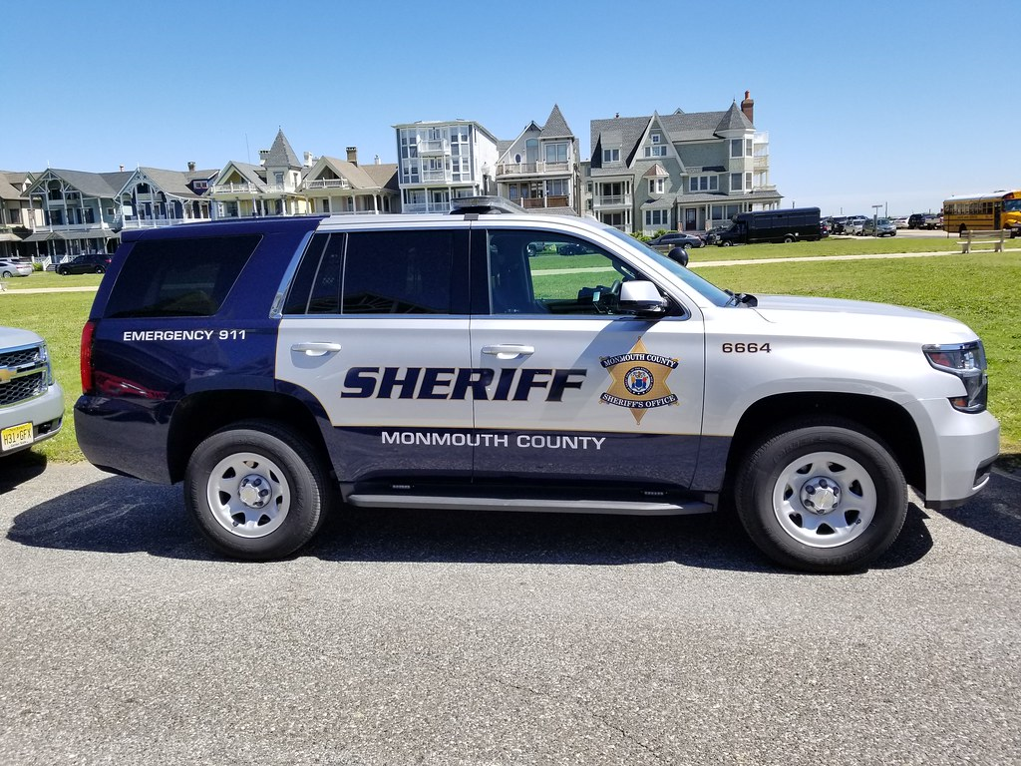

Slide 13
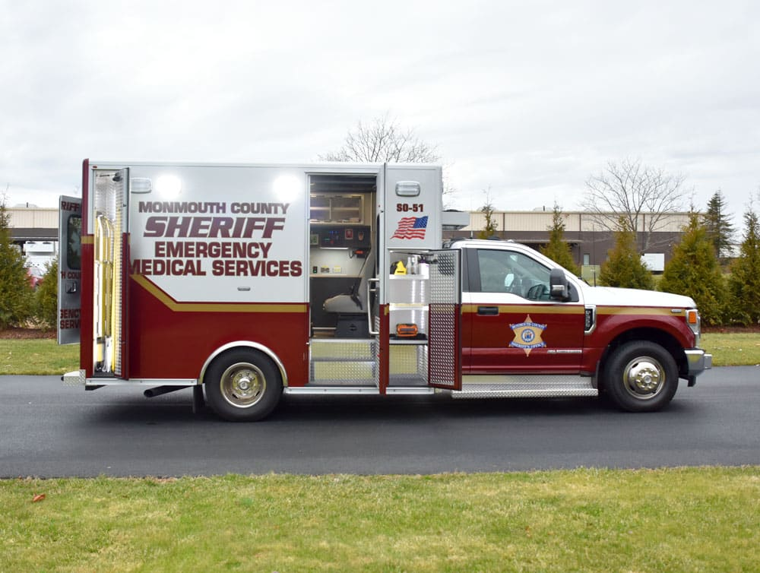

Slide 14
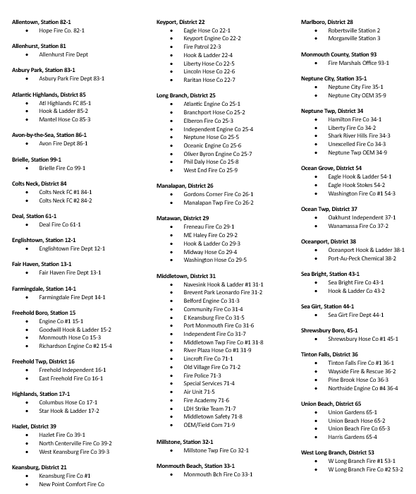
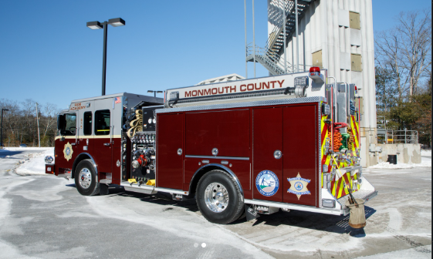

Slide 15
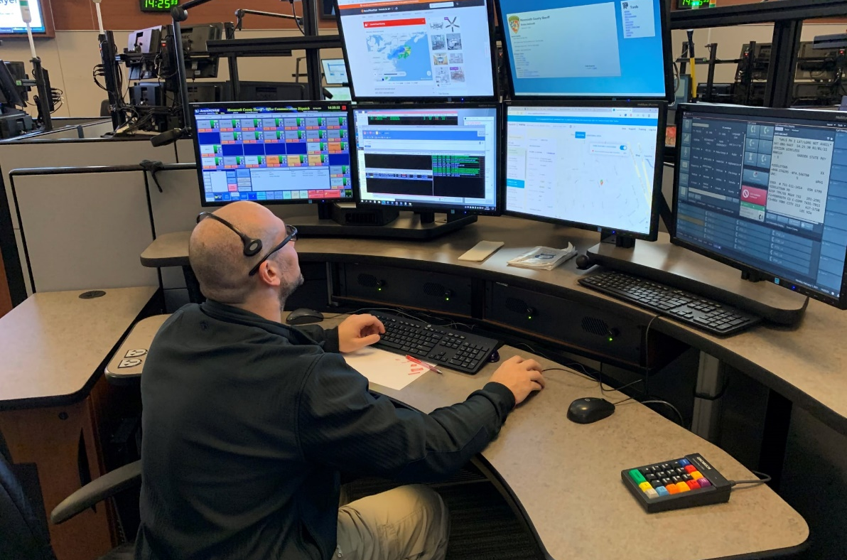
Staffing Model and Schedule Expectations
This is a shift-based public safety environment designed around agency need and union agreement.
Current staffing
Typical full-time schedule
1
Pitman schedule • 12-hour shifts
2 on / 2 off • every other weekend off
Week 1 and Week 3 match; Week 2 and Week 4 match
Undersheriff
1
9-1-1 Coordinator
7
Supervisors
14
Senior PSTs
Important reality of the role
Shifts are assigned based on agency need and union agreement.
100+
PSTs
The role includes holidays, weekends, and around-the-clock coverage.
Mandatory overtime may create 16-hour days or 4-day work stretches when operationally required.
24 hours a day • 7 days a week • 52 weeks a year
Notes:
[Sources]
- User-provided source deck: "2024 Monmouth County Sheriffs Office Orientation 1-22-2026 rev.pptx" (content adapted and redesigned)

Slide 16
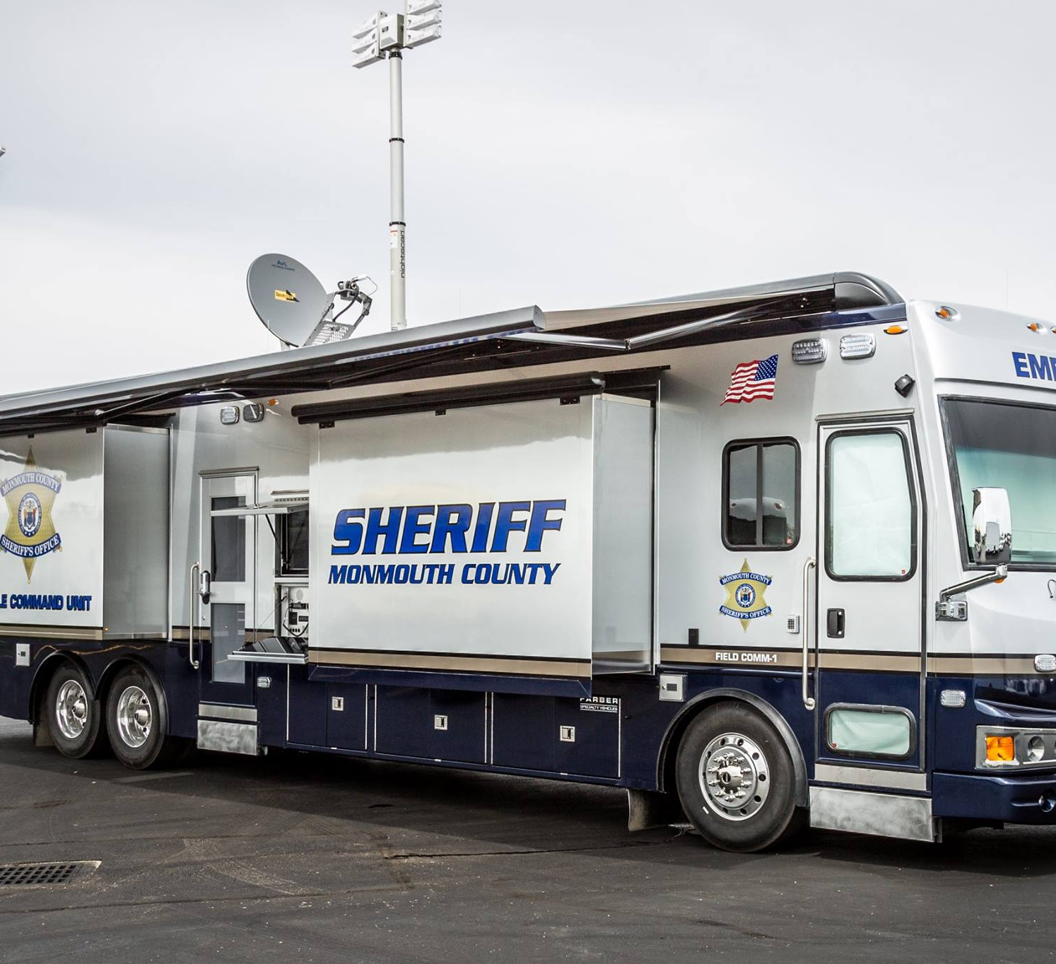

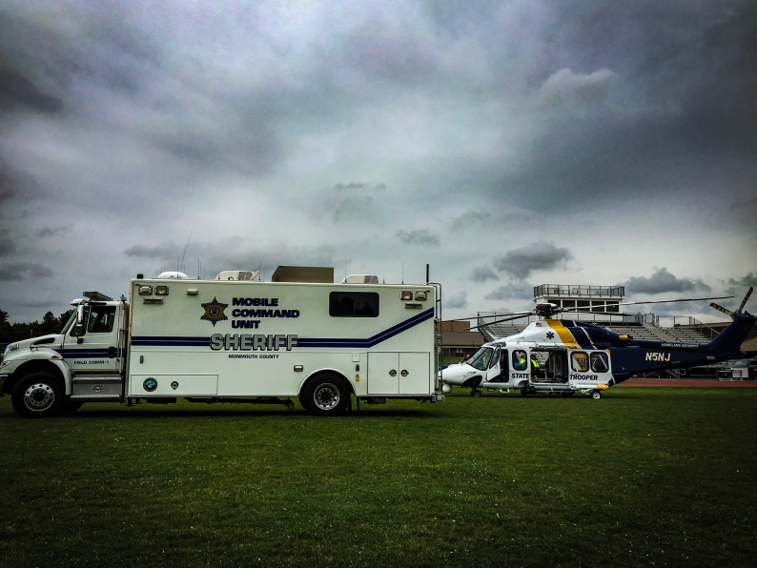
Field Communications and Incident Support
Communications extends beyond the console when field operations need mobile, interoperable support.
Responds to:
Emergency response incidents and major events
Large fires and mass casualty incidents
Hazardous materials incidents
Non-emergency deployments, parades, and celebrations
DWI / DMV operations and other specialty support needs
Field communications enables coordinated response when fixed dispatch infrastructure is not enough by itself.
Notes:
[Sources]
- User-provided source deck: "2024 Monmouth County Sheriffs Office Orientation 1-22-2026 rev.pptx" (content adapted and redesigned)

Slide 17

Working Test Period
New regular appointments are subject to a structured working test period under NJ CSC rules.
90 days
Regulatory reference
NJ CSC 4A:4-5.1 describes the working test period as part of the appointment and evaluation framework for career service titles.
with three 30-day evaluations
Part of the examination process used to determine whether duties can be performed satisfactorily.
Employees serve in and perform the duties of the title during this period.
What to expect
Employees serving a working test period are not eligible for a promotional exam from that title.
Performance is watched closely while you learn the console, policies, and workflow.
Evaluations are staged rather than left to a single final review.
Consistency, policy compliance, and learning pace matter early.
Notes:
[Sources]
- User-provided source deck: "2024 Monmouth County Sheriffs Office Orientation 1-22-2026 rev.pptx" (content adapted and redesigned)

Slide 18
Training Journey for New Operators
The program blends classroom instruction, live call handling, and supervised console time.
14-16 weeks total:
911 Officer Course / EMD Course / CPR
Training schedule is assigned by administration; release assignment depends on operational need.
1
Classroom foundation
2
Testing and codes
3
CTO-led live training
About three weeks covering CAD, phones, Infolink files, NCIC, eAgent, NJ Courts, police dispatch, and scenarios.
Town codes, 10-codes, and other benchmarks are tested before release to live work.
Call taking, emergency handling, police dispatch, and after-hours procedures are trained with CTOs.
CTO coverage includes non-emergency and emergency call taking, EMD instruction, police dispatch, NCIC / eAgent / NJ Courts, and after-hours / on-call procedures.
Notes:
[Sources]
- User-provided source deck: "2024 Monmouth County Sheriffs Office Orientation 1-22-2026 rev.pptx" (content adapted and redesigned)

Slide 19
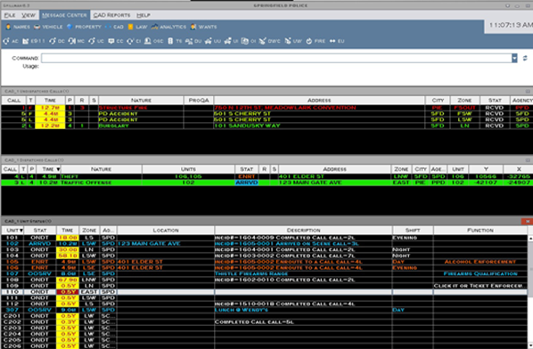
Training Prerequisites and Required Systems
Candidates are expected to arrive with core certifications and maintain them.
Expected before or during onboarding
CPR, EMD, and BTC / 9-1-1 officer credentials as applicable
The training environment includes CAD, phone systems, Infolink files, NCIC, eAgent, NJ Courts, dispatch workflows, and scenario-based practice.
ICS 100, 200, 700, and 800 (FEMA IS courses)
CJIS / NCIC access training
EAgent, Spillman CAD, and PowerTime / PowerDMS / CALEA familiarity
Town codes and 10-codes testing
Bottom line
Training is not just about finishing the calendar. It is about proving that you can apply policy, systems knowledge, and dispatch judgment consistently enough to operate safely on shift.
Maintain your EMD and CPR certifications now.
Expect steady evaluation, not a single pass/fail moment.
Notes:
[Sources]
- User-provided source deck: "2024 Monmouth County Sheriffs Office Orientation 1-22-2026 rev.pptx" (content adapted and redesigned)

Slide 20

Hiring Process and Candidate Expectations
The selection path is structured, and candidate communication rules are explicit.
Selection flow
1
Background check
and formal interview
2
Psychological exam
3
Medical / drug
screening exam
Do not call or e-mail the Communications Division to check hiring status.
Disqualification triggers
Failure to complete the secondary application properly
Applicants who do so will be removed from the eligibility list.
The office will contact you.
Failure of the background check
Failure to complete the psychological or medical exam (eligible to reapply in one year)
Notes:
[Sources]
- User-provided source deck: "2024 Monmouth County Sheriffs Office Orientation 1-22-2026 rev.pptx" (content adapted and redesigned)

Slide 21

Compensation
Base pay is defined by contract, with separate temporary / part-time rules and rates.
Temporary / Part-Time PST
$58,116
Requires current dispatcher / call taker experience
starting salary for 2026
Requires 9-1-1 Officer / Basic Telecommunicator certifications
Current contract: CWA 1075
Subject to change based on the union contract expiring December 2025
EMD is preferred
Part-time rates and hour limits
Annual appointments • 25 hours/week max for retirees • 28 hours/week max for all others • On-call and open-shift sign-ups when shifts are less than 72 hours away
$32/hr while training
$36/hr after training completion
Notes:
[Sources]
- User-provided source deck: "2024 Monmouth County Sheriffs Office Orientation 1-22-2026 rev.pptx" (content adapted and redesigned)

Slide 22
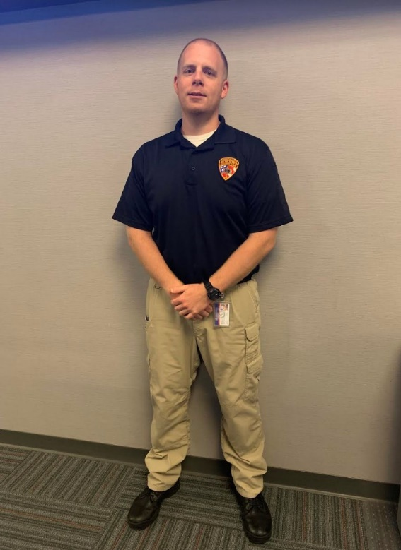

Uniforms, Leave, and Benefits
After training completion, operators move into the standard employment package and issued items.
Uniform issue after training
Leave
Benefits
2 long-sleeve shirts
Paid Vacation
96 hours: first 5 years
120 hours: years 6-12
160 hours: years 13-20
200 hours: after 21 years
Personal time
24 hours per year
Retirement plan under the Public Employees Retirement System (PERS)
2 short-sleeve shirts
2 pairs of pants
1 belt
Medical and prescription coverage with employee contributions based on salary and plan
1 pair of boots
Optional dental and optical coverage with employee contributions
Notes:
[Sources]
- User-provided source deck: "2024 Monmouth County Sheriffs Office Orientation 1-22-2026 rev.pptx" (content adapted and redesigned)

Slide 23
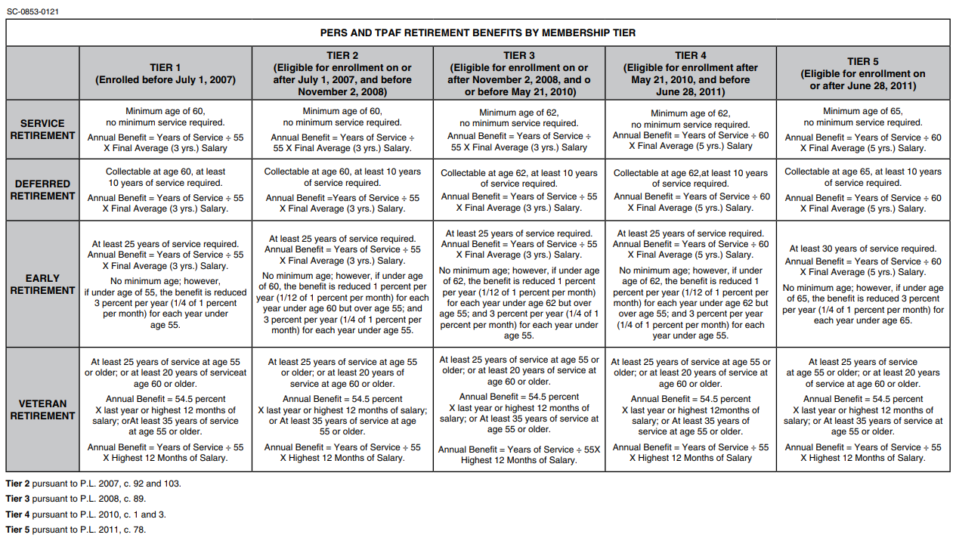
Notes:
[Sources]
- User-provided source deck: "2024 Monmouth County Sheriffs Office Orientation 1-22-2026 rev.pptx" (content adapted and redesigned)

Slide 24
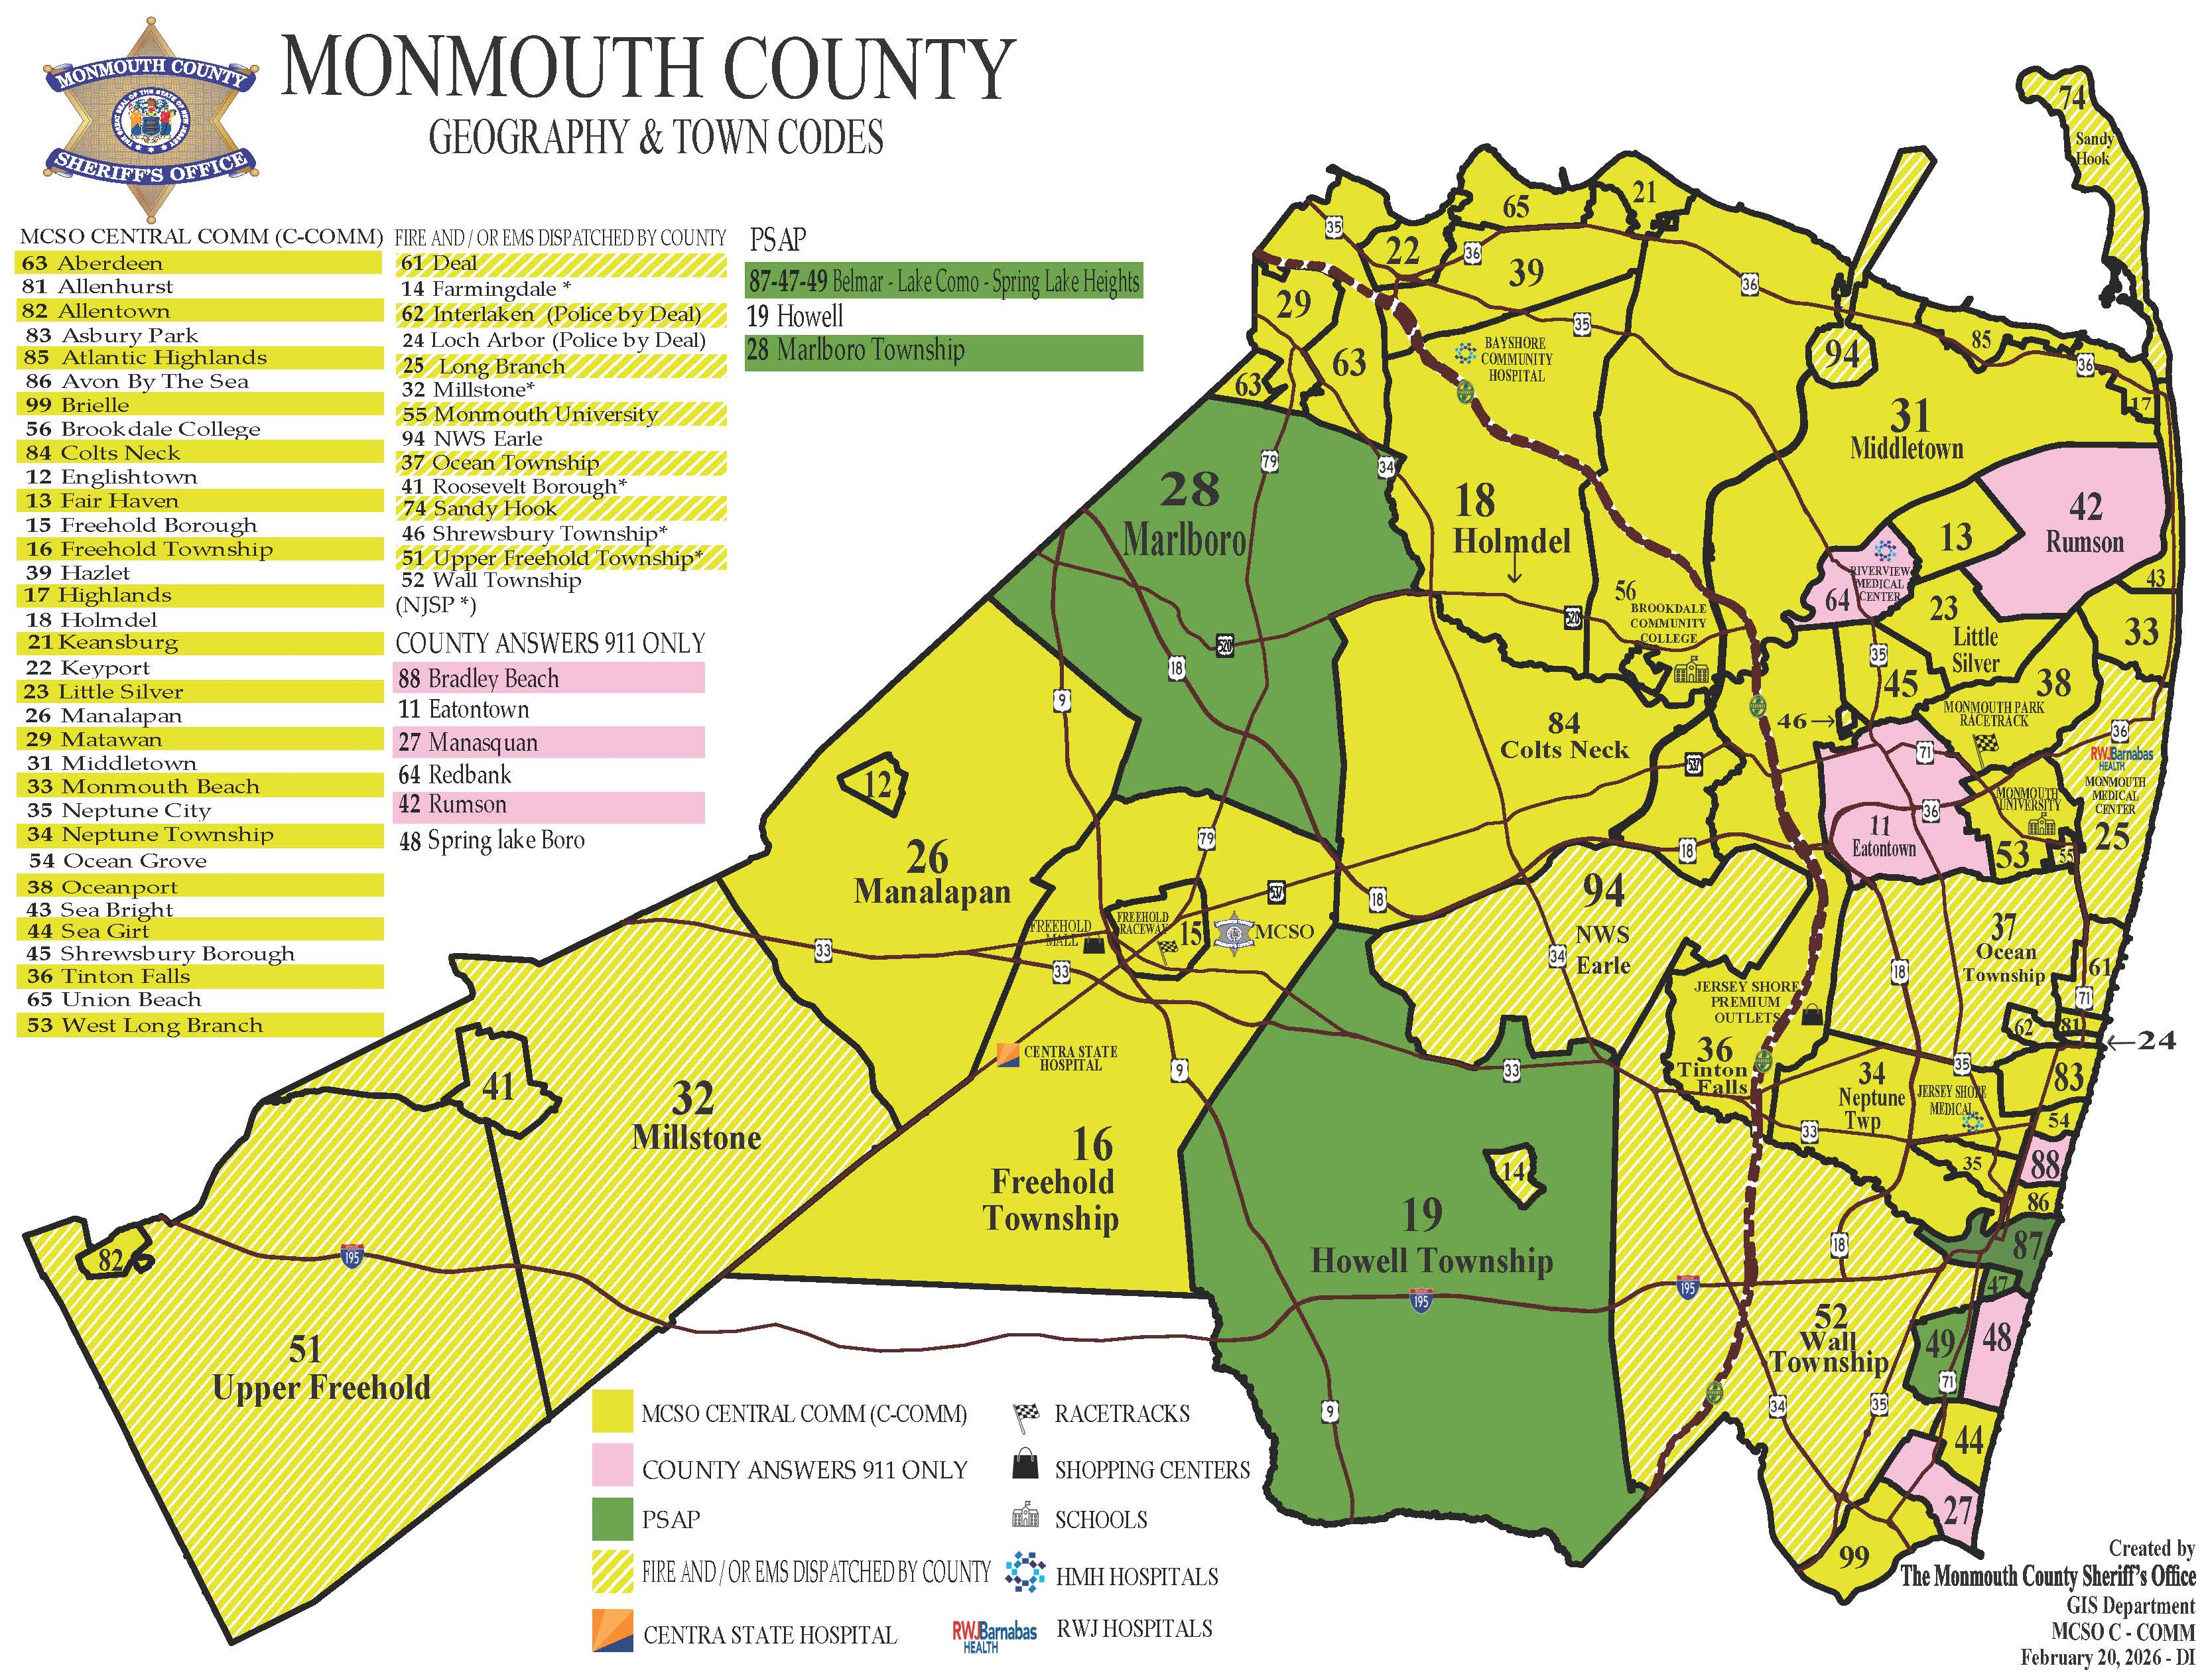

Slide 25











24-7 Holidays & Weekends

Slide 26

Prepare for Success
Stay connected
Website, mobile app, and QR access points from the source presentation are preserved here for easier follow-up.
Know the town codes.
Study state and county parks in Monmouth County.
Build working geography of the county.
Have your certifications and driver's license ready.
Send required documents to Stephanie Itri at sitri@mcsonj.org.
Questions?
www.monmouthsheriff.org
#MCSONJ
Notes:
[Sources]
- User-provided source deck: "2024 Monmouth County Sheriffs Office Orientation 1-22-2026 rev.pptx" (content adapted and redesigned)

